Slide 1
Strings

Slide 2

Agenda
First introduction to classes and objects.
We will discuss the String class.
References.
String methods.
Outline some “gotchas” concerning reference types and testing for equality.

Slide 3
Difference between char and String
Char:
Single Unicode character.
Primitive type.
Internally stored as a number (occupying 2-bytes).
String
Text (sequence of characters).
Object (data + functionality in the form of methods).
Links about Unicode:
https://en.wikipedia.org/wiki/Unicode
https://unicode-table.com/en/
Notes:
Presenter
2019-10-04 11:08:24
--------------------------------------------
So not only can we store the values, we also have different functions that we can use for this value type (class = complex type)

Slide 4
Quick introduction to methods
Methods are blocks of code that perform a particular function.
Methods are given a name; a list of any values needed to perform the function and provide a return type for any values returned from the method.
Many methods have already been written for us, such as nextInt().
We will also be writing our own methods from next week. But here’s a quick example using IT Lab Week 2, Q8 (TempConversionQ.java).
Notes:
Presenter
2019-10-04 11:08:24
--------------------------------------------
From Tutorial 2, Q8 Open Tut2 Q8 too Test data
78F = 25.55556
30C = 86F

Slide 5
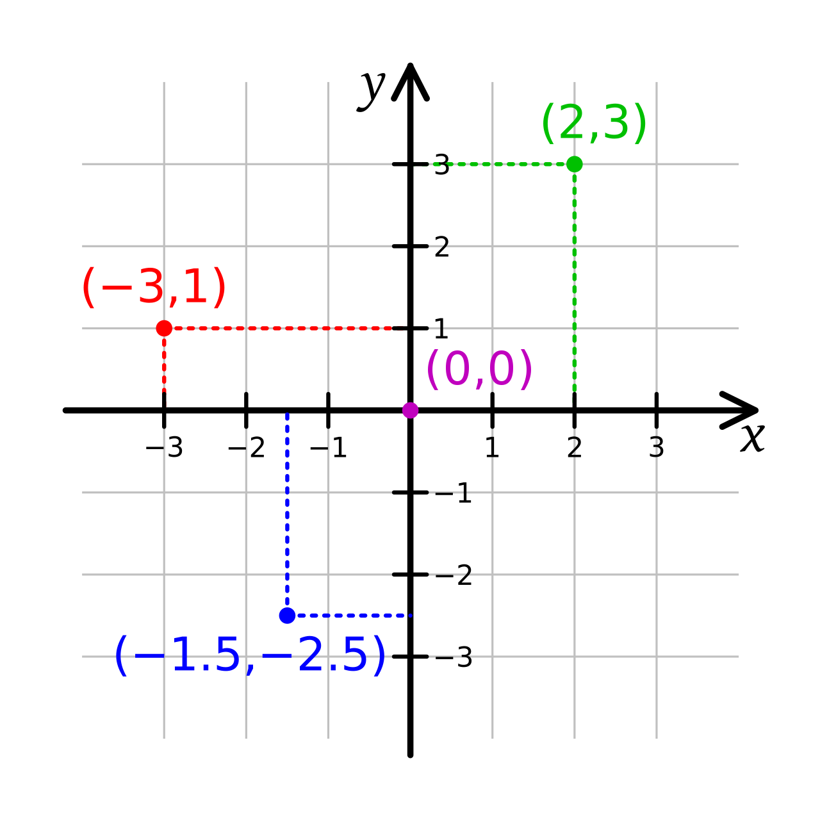
Quick introduction to Classes
Classes are written to define one thing/object, e.g. a staff record; gym membership record; a bank account; a String;
You also include class methods to define what functions can be performed on this object, and how the functions must be carried out.
You create instances of your class using a special method inside the class called a Constructor.
Let’s create point.java

Slide 6
Introduction to the String class
A String is a collection of characters making up text.
We have already been using String literals – e.g.
System.out.println("String text");
System.out.println("The total is: " + total);
The String class already exists in the Java library;
part of the java.lang package (imported automatically),
has several initialization options (constructors),
has methods to manipulate text.

Slide 7
The String class - Definitions
Classes allow groups of related data (variables) and methods to be defined - more later in the course.
Objects are complex variables that are based on class definitions - more later.
A literal is the source code representation of a fixed value.
To instantiate a new String object variable:
new keyword
String firstName = new String("Andy");
literal
String reference variable
class name
String lastName = "Warhole"); // special shortcut
Notes:
Presenter
2019-10-04 11:08:25
--------------------------------------------
So….. The String class is a class that has already been written for us. It has many, many methods that we can use to manage Strings. When we create a String we are creating an object, i.e. creating a String object, and we must give that object a name, e.g. firstName. We create our object by calling the constructor for that class, using the keyword new i.e. We have created an instance of the String class

Slide 8
The String class
String object identifiers (String variables) can be assigned to other Strings:
String homeTeam = "Middlesbrough";
String favouriteTeam;
favouriteTeam = homeTeam;
The object reference favouriteTeam now refers to the same String as the homeTeam object reference:
homeTeam
M | i | d | d | l | e | s | b | r | o | u | g | h
0 | 1 | 2 | 3 | 4 | 5 | 6 | 7 | 8 | 9 | 1 0 | 1 1 | 1 2
favouriteTeam
Strings can be joined together to form a new String – concatenation:
String myFullName = firstName + lastName;

Slide 9
Displaying a String
String variables can be output with println():
System.out.println(fullName);
Primitive variables can be concatenated with a String objects:
int myAge = 21;
System.out.println(fullName + " is " + age + " years old");

Slide 10
Inputting a String
The Scanner class method next() will read up to a white space:
Scanner myInput = new Scanner(System.in); // create Scanner object
System.out.println("What's your name?");
String name = myInput.next();
System.out.println("The name you entered was " + name);
If the user types characters that include spaces then the reading stops at the first space, so name will not include any characters after the space.
To read a String line including spaces use the Scanner method nextLine()
String name = myInput.nextLine();
See Java Strings document on Blackboard for more examples of the String class and its methods

Slide 11
Quiz (1)
When the following code is executed, what will be printed to the console?
String redHerring = "Baa, baa, black sheep";
int a = redHerring.length();
System.out.println(a);

Slide 12
Quiz (2)
When the following code executes, what is printed?
String festival = "Christmas";
System.out.println(festival.indexOf('s'));
System.out.println(festival.lastIndexOf('s'));

Slide 13
Quiz (3)
When the following code is executed, what will be printed to the console?
String fastFood = "pepperoni and mushroom pizza";
System.out.println(fastFood.substring(0, 6));
System.out.println(fastFood.substring(14,18));

Slide 14
Quiz (4)
Consider a String with a first, middle and last name e.g.
“Christian Scott Tomas”
How can you use String methods to extract the middle name from the String?

Slide 15
The Java API
The Java API (for those who want to know more):
To find details of existing Java classes and methods refer to: http://download.oracle.com/javase/8/docs/api/
In the top left frame select java.lang package.
Then in the lower left frame select String from the list of classes.
In the right frame you scroll through the String class details, constructors and methods.

Slide 16
Testing for equality
Testing equality with an object of a class isn’t the same as testing equality with a primitive variable
int a = 6;
int b = 6;
if (a == b) ..... // true
Consider …
String string1 = new String("Test");
String string2 = new String("Test");
String string3 = string1;
if (string1 == string2)...
if (string1 == string3)...
… and
// false (different objects)
// true (same object)
The first if tests to see if the two reference variables string1 and string2 refer to the same object ....they don’t.
To test for the equality of string objects of a class we require a method, ie code to determine if they are equal.
Notes:
Presenter
2019-10-04 11:08:26
--------------------------------------------
The method must decide how to establish equality

Slide 17
String method: equals()
Syntax: Usage: Returns:
Arguments:
boolean equals(String)
myString.equals()
boolean
String
Compares the current String to that given in the argument
Example
String example = "BOB";
boolean b = example.equals("BOB");
System.out.println(b);
Similar method: boolean equalsIgnoreCase(String)

Slide 18
Quiz (5)
What is the value of result when the following code is executed?
String first = "Java is great!";
String second = "Java is ";
String third = "great!";
second = second.concat(third);
boolean result = first.equals(second);

Slide 19
Quiz (6)
When the following code is executed, what will be printed to the console?
final String pig = "length: 10";
final String dog = "length: " + pig.length();
System.out.println("Animals are equal: " + pig == dog);
Beware!
All is not as it seems!!!

